Slide 1

WeCook Project
By the creators of Jet Pack Man and Ice Cream Shop
Gonçalo Vilaboim & Guilherme Ferreira

Slide 2

ACTION PLAN
WeCook Project
Step 01
Step 03
Step 05
What is the project about?
Technologies used
Let’s Try!
01
02
03
04
05
Step 02
Step 04
Features of the project
Screens Before/After

Slide 3

SPECIFIC
WeCook Project
WeCook defenition
A video content platform based on a social network.
This project is based on the combination of two ideas.
A cooking recipe platform.
WeCook!

Slide 4





WeCook Features
Users
Channels
Videos
Messages
Create User
Update User
Update Channel
Upload Videos
Subscribe
Search & Watch
Like & Deslike
Reviews
Recipes & Macros
Notifications
Send Messages
Receive Messages

Slide 5

WeCook Technologies
Upload Images
Upload Videos
Database
Atlas
Cloudinary
Auth0
Cyclic
Fat Secret
Login
Register
Sessions
Hosting
Get the Macros of ingredients

Slide 6
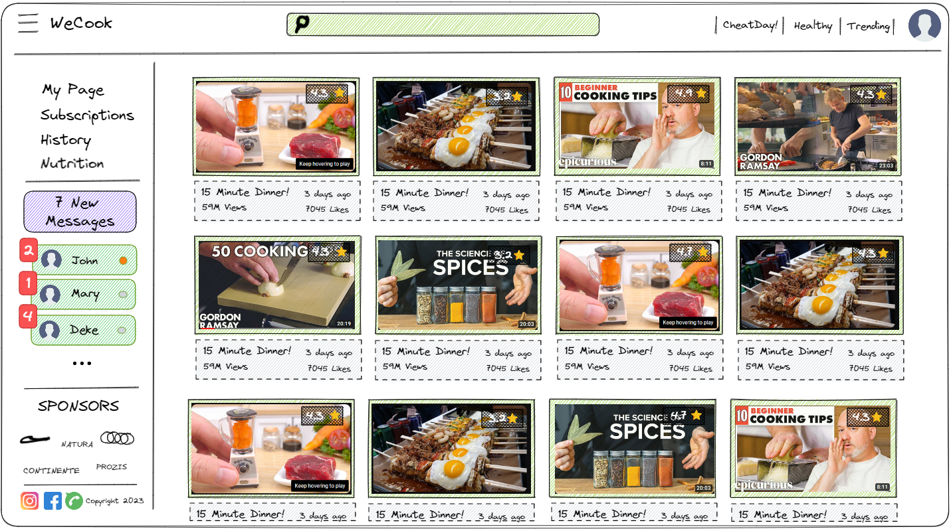
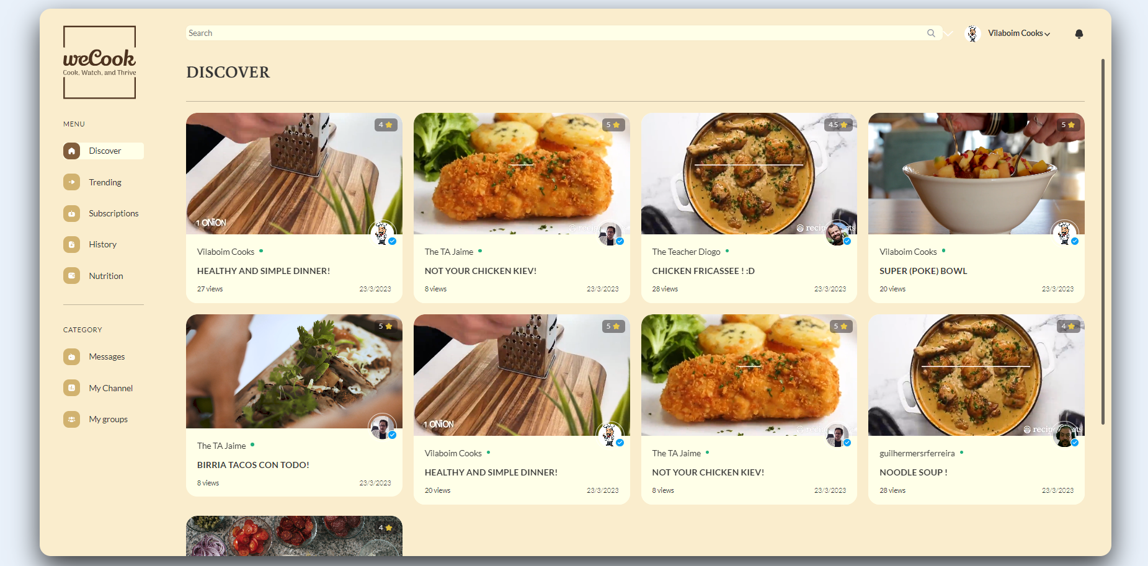
WeCook Screens
Home Page - Before
Home Page - After

Slide 7
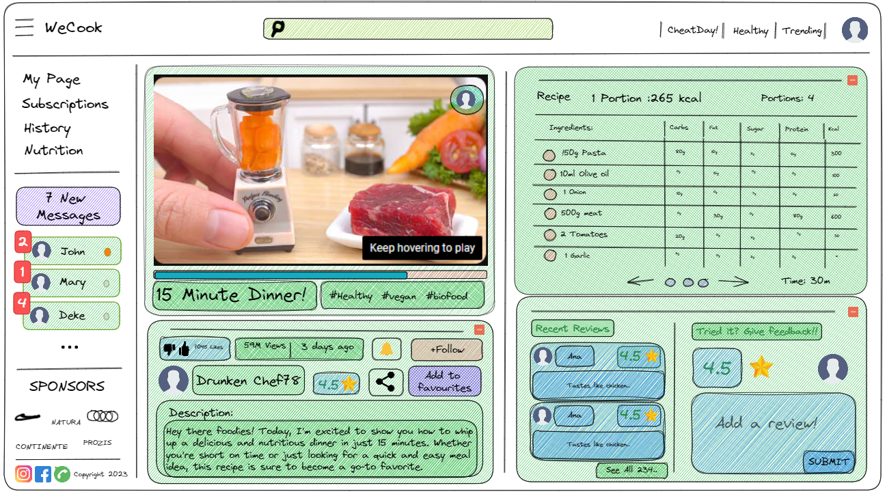
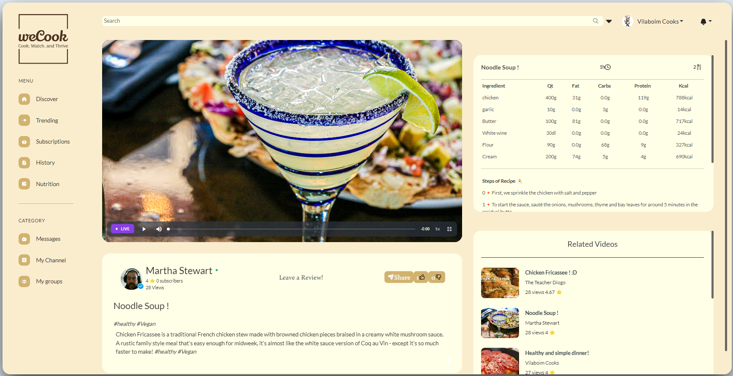
WeCook Screens
Watch Page - Before
Watch Page - After

Slide 8
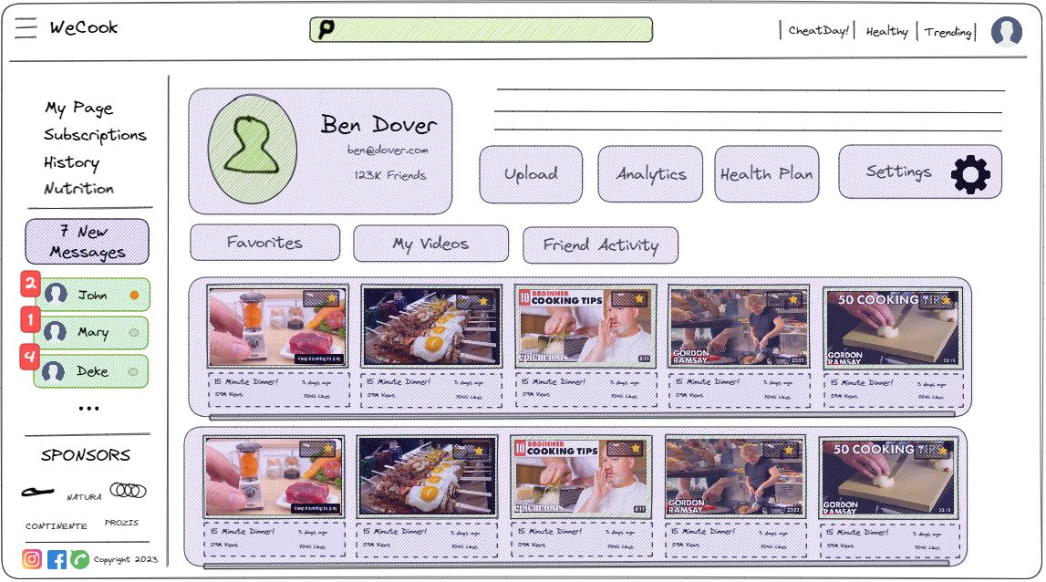
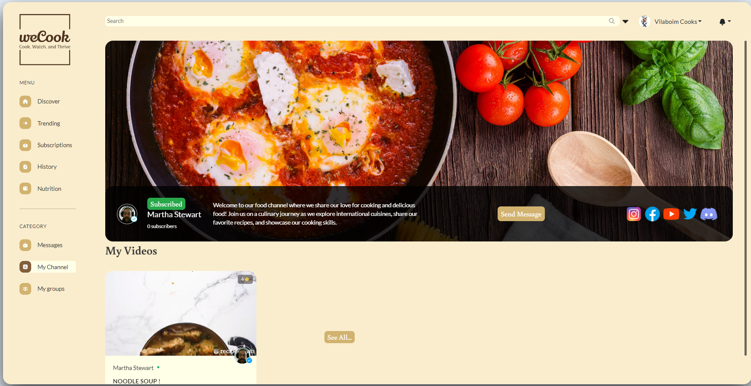
WeCook Screens
Channel Page - Before
Channel Page - After

Slide 9
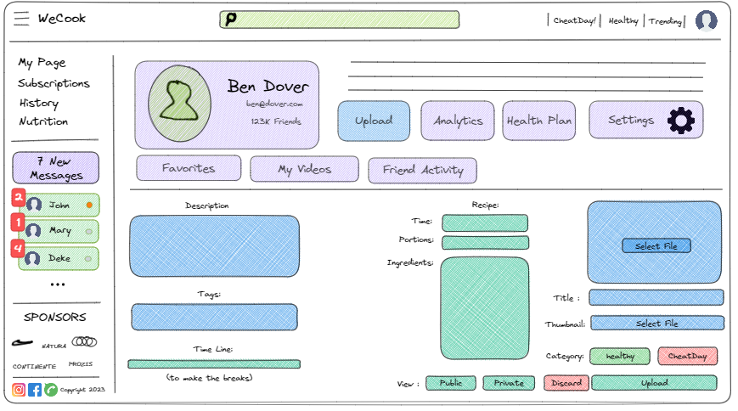
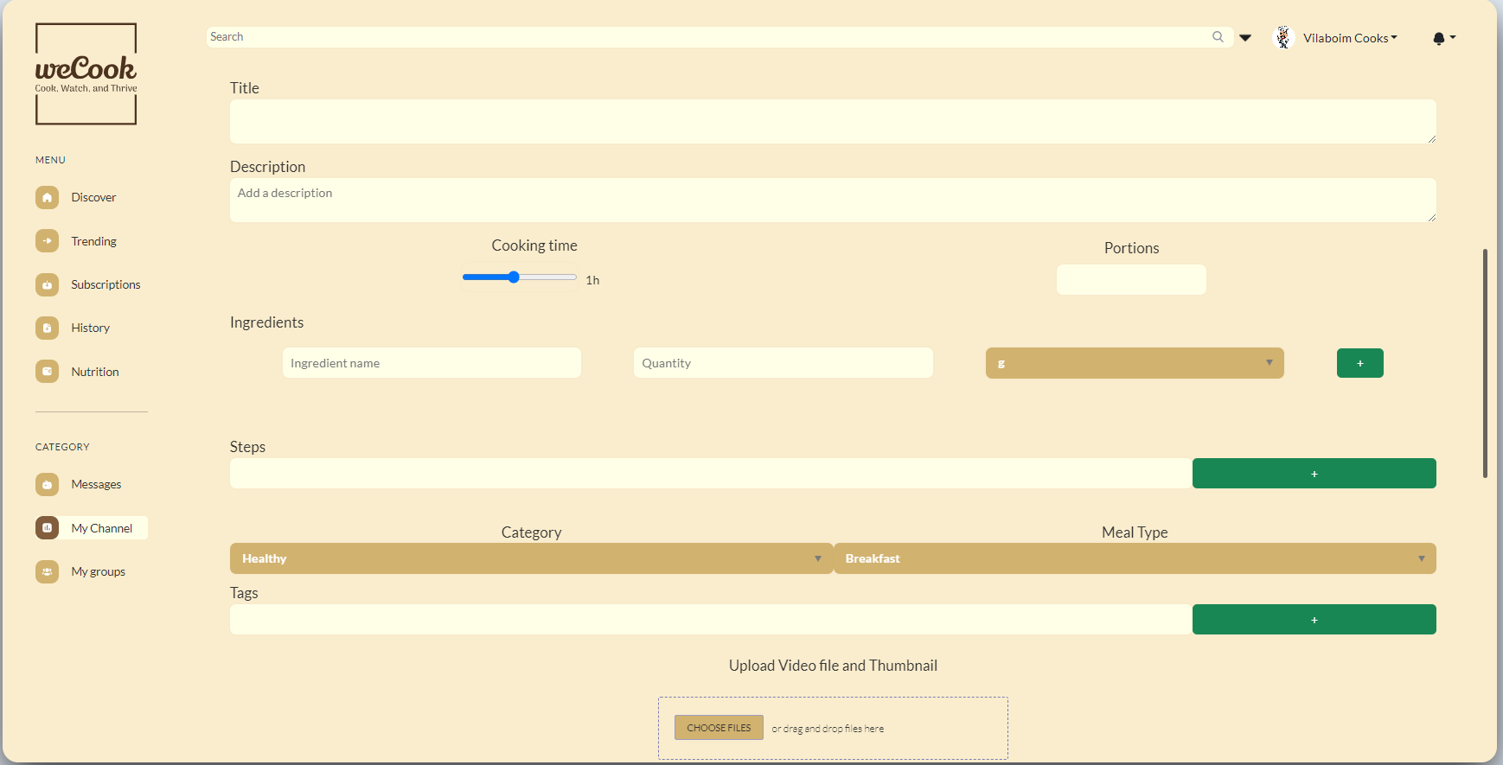
WeCook Screens
Upload Page - Before
Upload Page - After

Slide 10
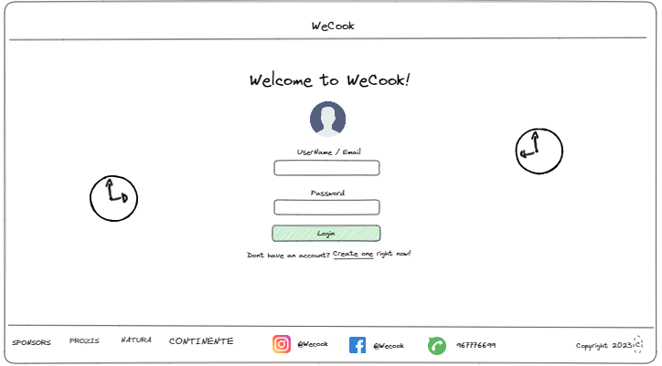
WeCook Screens
Login Page - Before
Login Page - After

Slide 11
Thanks for Watching!
Lets take a look!
https://wecook.cyclic.app/

